Slide 1
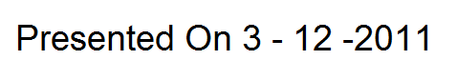
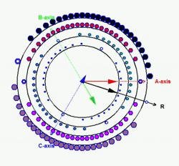
Faculty Development Program
PWM – Techniques for Power Electronics in Power Systems
By
M.Senthil Kumaran
&
R.Ramesh
“Design is a funny word. Some people think design means how it looks. But of course, if you dig deeper, it's really how it works.”
- Steve Jobs
“If you Know anything Teach it to others, If you don’t, learn it from others”
--Tryon Edwards

Slide 2
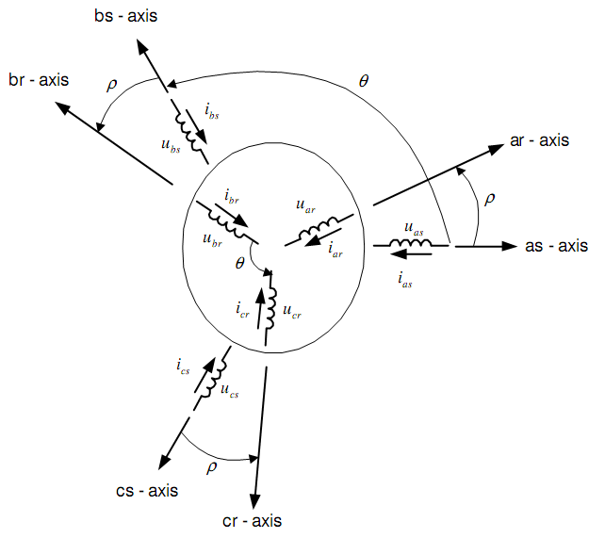
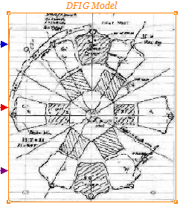
Space Vector insight from a Machines
Production of Space Vector in Machines
When spatially distributed windings are supplied with time displaced currents
The Resultant Flux in the space [ Air gap] - Rotates
The speed of rotation is given by
120* f / P
Two – Field Revolving Theory

Slide 3
Three Stationary Windings Becomes a Single Rotating Winding
When windings are Excited by three phase Sinusoidal currents the combined effect is equivalent to single Sinusoidally distributed winding excited with a constant DC currents and Rotating at the excited frequency.
The speed of rotation is given by
120* f / P
Two – Field Revolving Theory

Slide 5
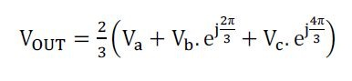
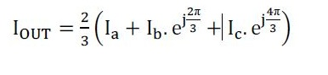
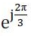
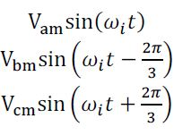
Mathematical Representation of - SV
Where represents the spatial displacement of the winding by 120 degree in the complex plane.
Represents the time displaced voltages in space displaced 3 phase windings.

Slide 6
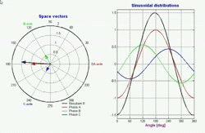
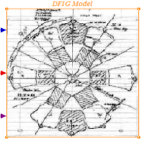
One who Sees Knows…….
One who Knows Shows……

Slide 7
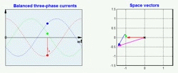

One who Sees Knows…….
One who Knows Shows……

Slide 8
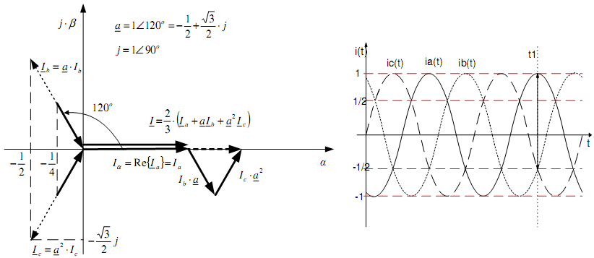
Graphical Representation of - SV
Space Vector formulation from a 3Phase System
I = [i_{a} – ½(i_{b}+i_{c})] +j[ [√3/2]*(i_{b}-i_{c})]
Mathematics is the only language of Engineer.

Slide 9
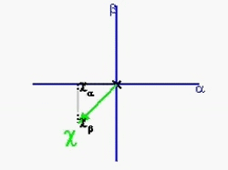
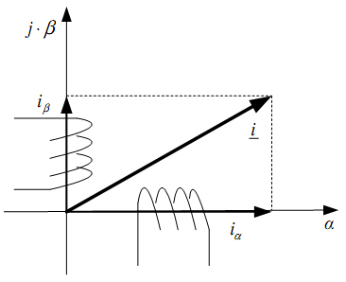
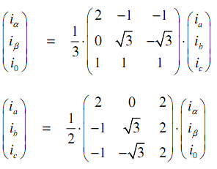
Representation of 3 phase as 2 phase system
Clark Transformation (α,β,0) – (a,b,c)

Slide 10
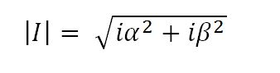
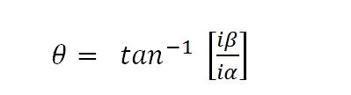
Representation of 2 phase system to a space Vector - | Mag | and Angle
Clark Transformation (α,β,0) – (a,b,c)

Slide 11


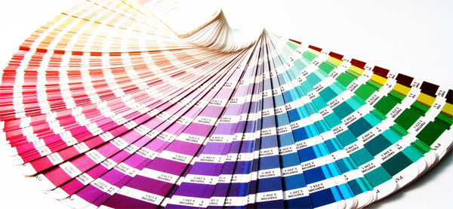
Reversing the Idea of Rotating Space vector of Machines – to apply in Converters for PWM technique
Three phase time varying Quantity applied to Space displaced Windings produce Equivalent single winding, rotating at supply frequency Excited by a DC voltage .

Slide 12

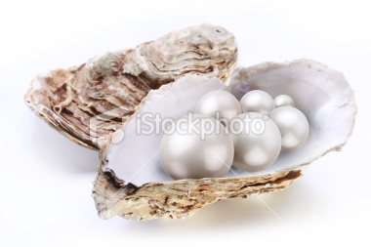
If you want the pearl don’t swim simply Dive

Slide 13
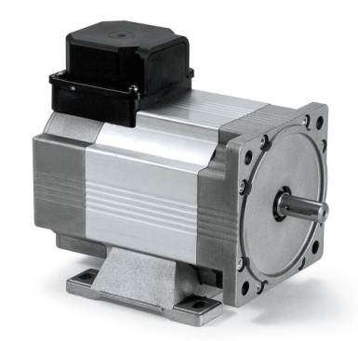
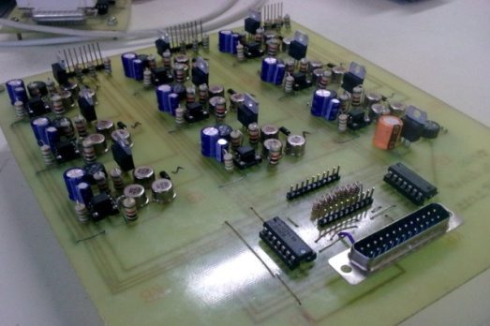
Space Vector From Machines To Power Electronics
Three phase time varying Quantity applied to Space displaced Windings produce an Equivalent single winding, rotating at supply frequency Excited by a DC voltage .
A DC voltage applied to an inverter can produce Three phase sinusoidal time varying outputs.
Where the inverter is made to behave like a three phase winding and Equivalent rotation of DC Voltage Excited winding is achieved through appropriate switching which imitates the Effect of Space Vector

Slide 14
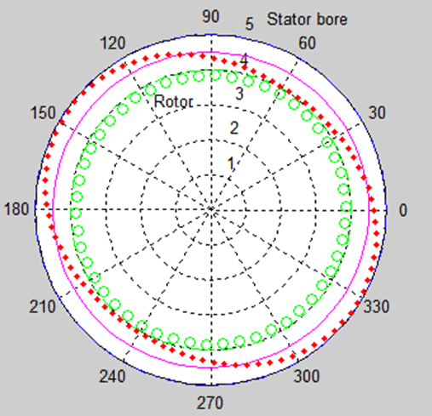
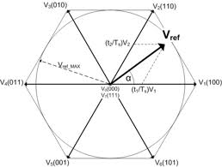
Space Vectors in Machines
Space Vectors in Power Electronics

Slide 15
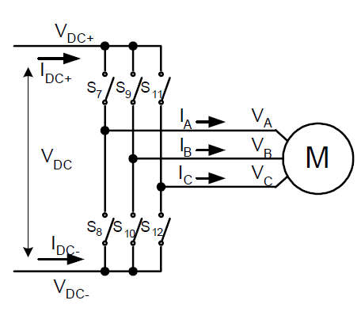
3 Phase Inverter Topology

Slide 16
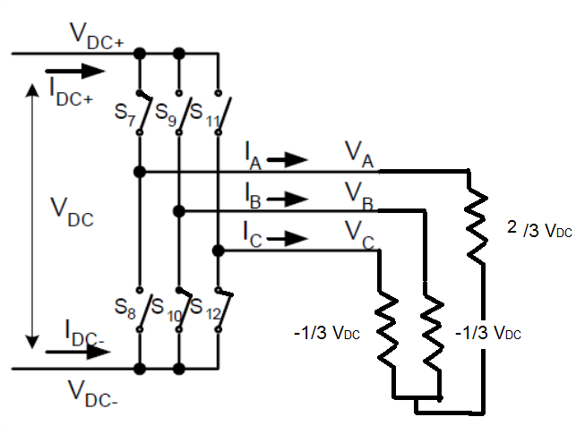
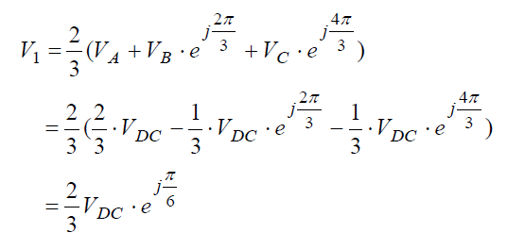
Equivalent Circuit for a Switching Pattern
Output Vector Position for Switching Pattern

Slide 17
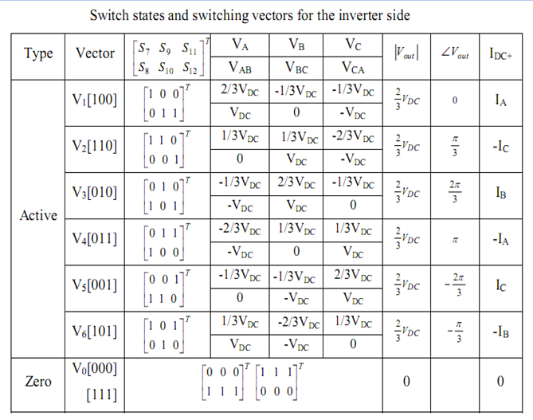
Switching Space Vectors in 3 Phase Inverter

Slide 18
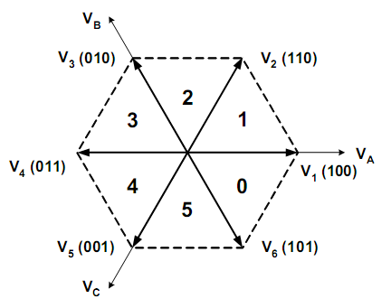
Graphical Representation of Switching Space Vectors in 3 Phase Inverter

Slide 19
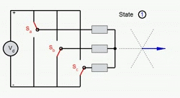
Graphical Representation of Switching Space Vectors in 3 Phase Inverter

Slide 20
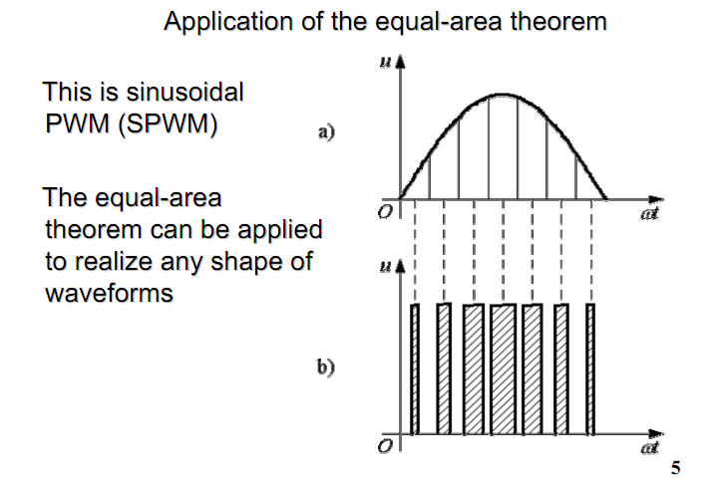
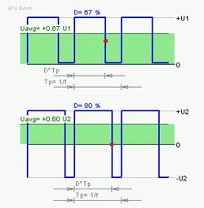
PWM in Power electronics
PWM - Methods…
Equal Area Theorem
Bang Bang Control
Volt-Second Balancing – Or -Other wise

Slide 21
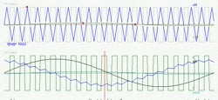
Sin PWM – Implementation of Equal Area Method

Slide 22
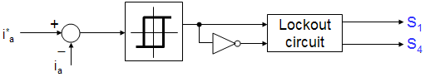
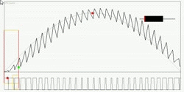
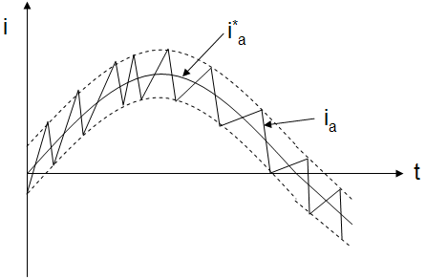
Hysteresis Control – Implementation of Bang Bang Method
Hysteresis Current Controller

Slide 23
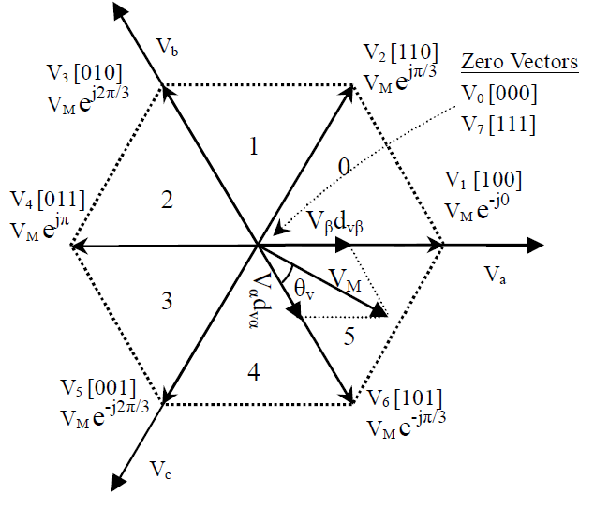
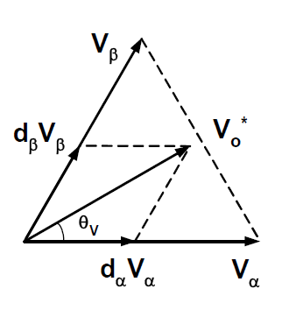
Volt Second Balancing – Implementation of SVM

Slide 24
Space Vector – Implementation of Volt –second Balancing Method
Dwell Time Calculation
Volt-Second Balancing
(10)
T_{a}, T_{b} and T₀ – dwell times for and
T_{s} – sampling period
Space vectors
, and
(1)

Slide 25
Space Vector – Implementation of Volt –second Balancing Method
- Dwell Times calculation
Solve (1)
(2)

Slide 26
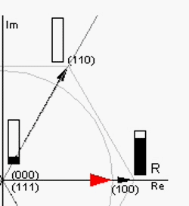
Space Vector – Implementation of Volt –second Balancing Method
-- V_{ref} Location versus Dwell Times

Slide 27
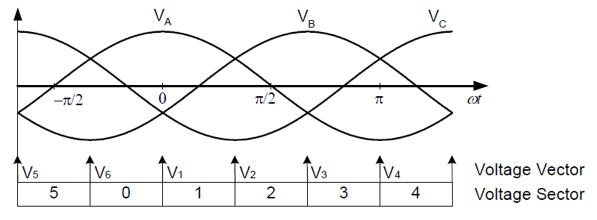
Space Vector - Sector Correspondence

Slide 28
Space Vector Modulation
Seven-segment Switching Sequence
Selected vectors:
V₀, V₁ and V₂
Dwell times:
T_{s} = T₀ + T_{a} + T_{b}
Total number of switchings: 6

Slide 29
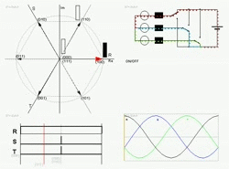
The Coordinated Dance of Vectors – Space Vector

Slide 30
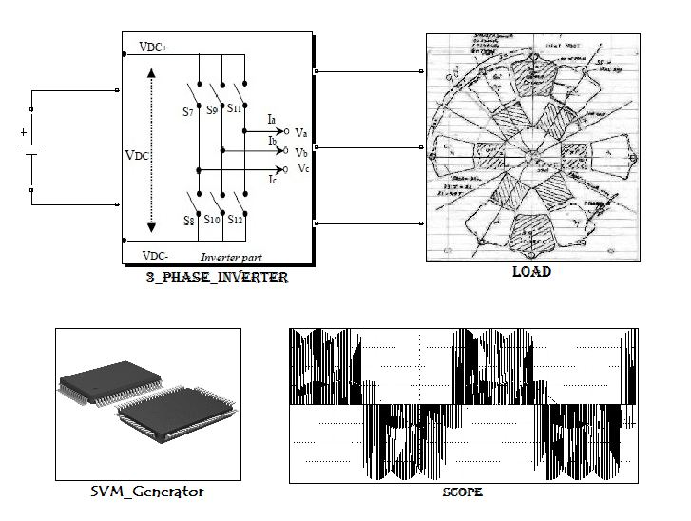
Don’t Stop With Hearing – Start Doing ……..

Slide 31
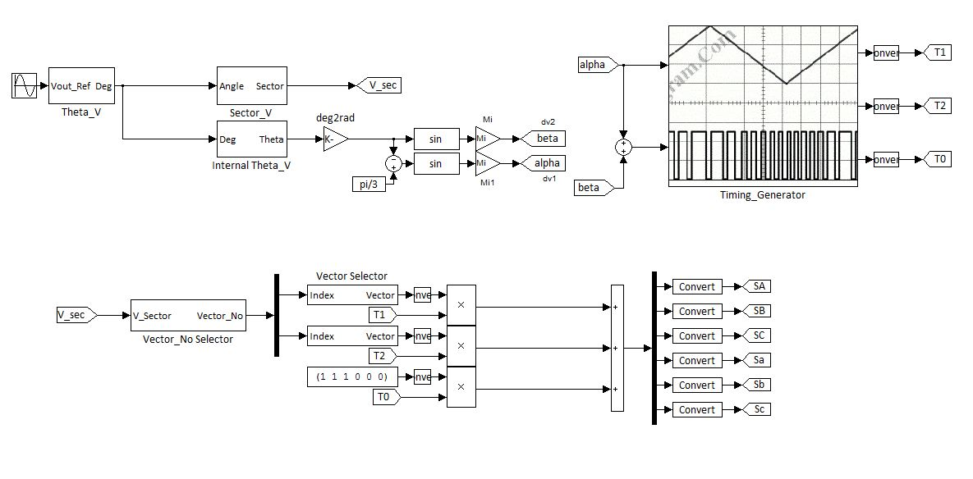
Don’t Stop With Hearing – Start Doing ……..

Slide 32
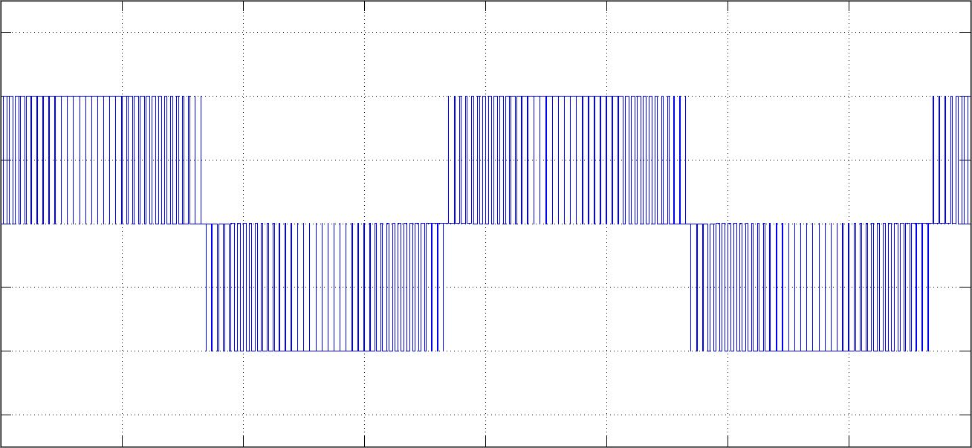
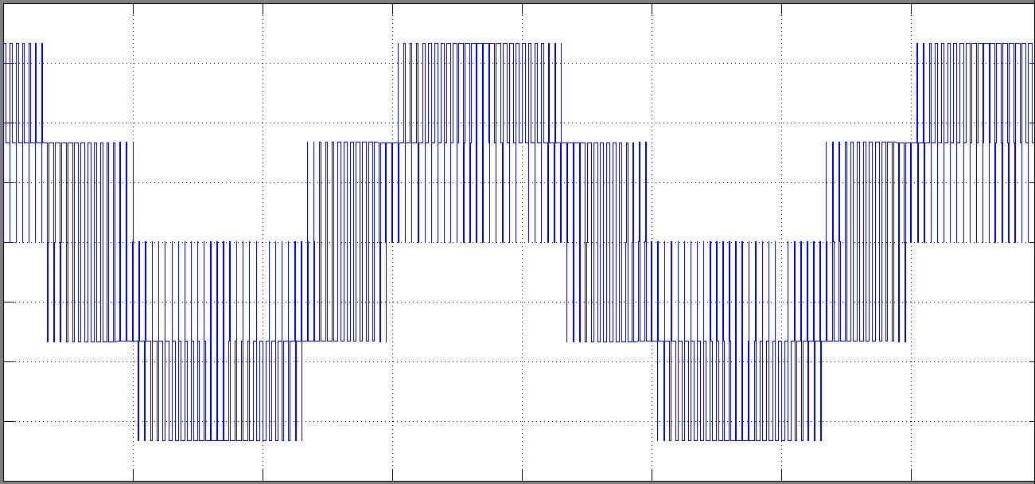
Output Line Voltage
Output Phase Voltage

Slide 33
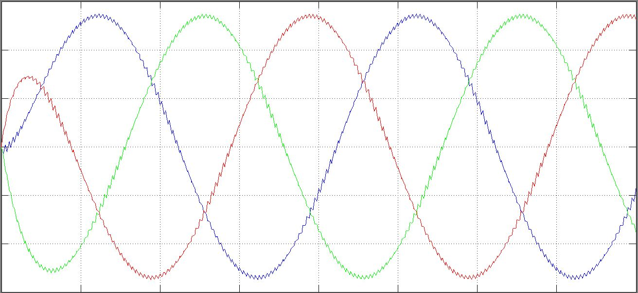
Output Current

Slide 34
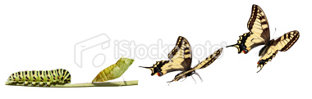
“Follow your heart. Being a caterpillar you will become a butterfly”
- ZnTill [ ]
“ ALL Is Well” – Raj kumar Hirani

Slide 35
Thank you...
-ZnTill [ ]
I said nothing it was all said earlier …..
“Cheerfulness Keeps the sprit of one who possesses it and brings a smile to the lips of others ”
Natural ability without education has more often attained to glory and virtue than education without natural ability
---- Cicero

